Slide 1
BATCH 2
SOLID REPORT

Slide 2
THIS WEEK’S OBJECTIVES
MELT AND RECAST KNSB GRAINS
MAKE TEST STAND ATTACHMENT FOR THE 1 GRAIN MOTOR
CONTINUE TEST OF LOAD CELL CIRCUIT AND CODE
DESIGN IGNITION CIRCUIT
OBTAIN THE 2.5 INCH SCH40 PIPE

Slide 3
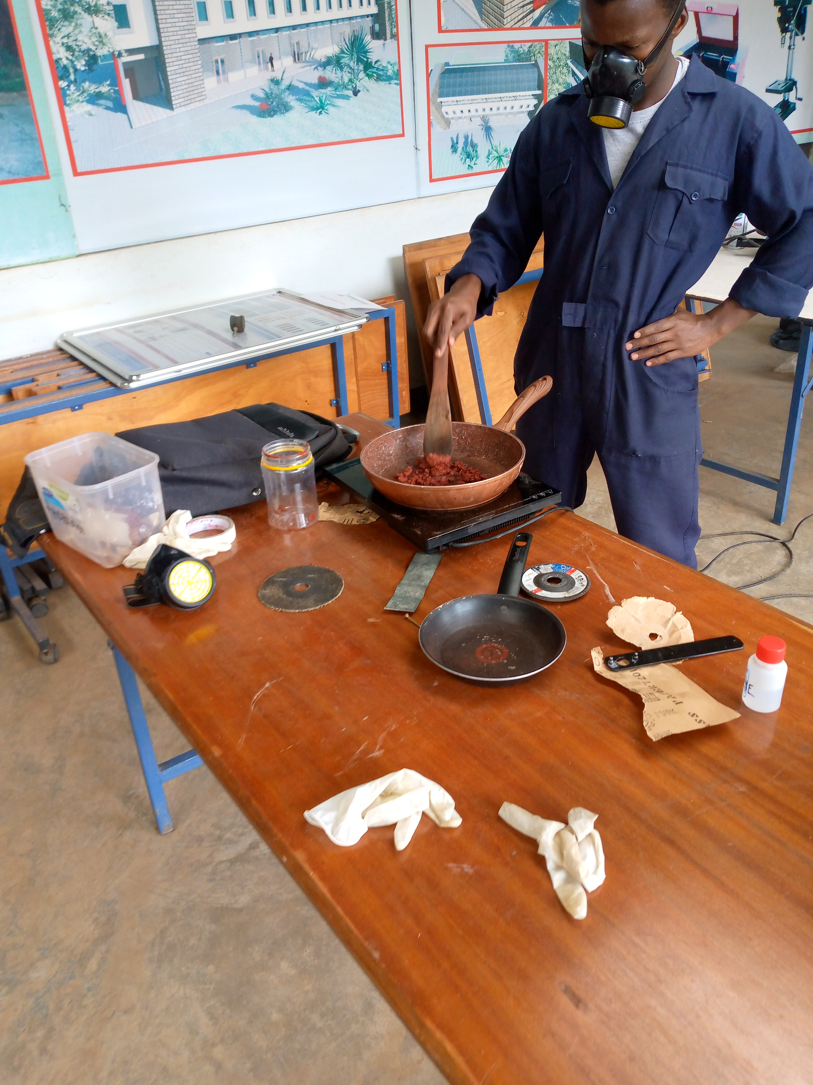
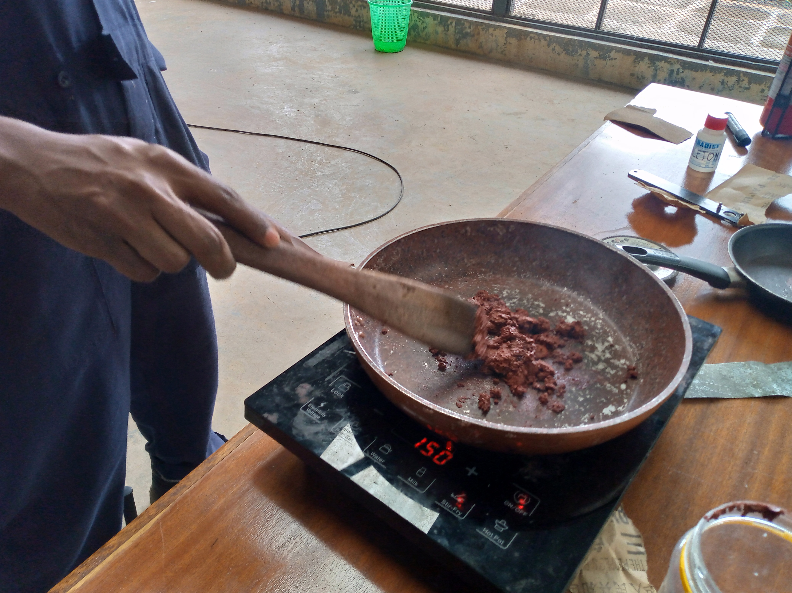
Melting and recasting of knsb grains
MELTED AND RECASTED TWICE AS PRACTICE , INORDER TO GAUGE THE VIABILITY OF THE PROCESS.
CONCLUDED THAT IT IS POSSIBLE TO MELT AND RECAST.

Slide 4
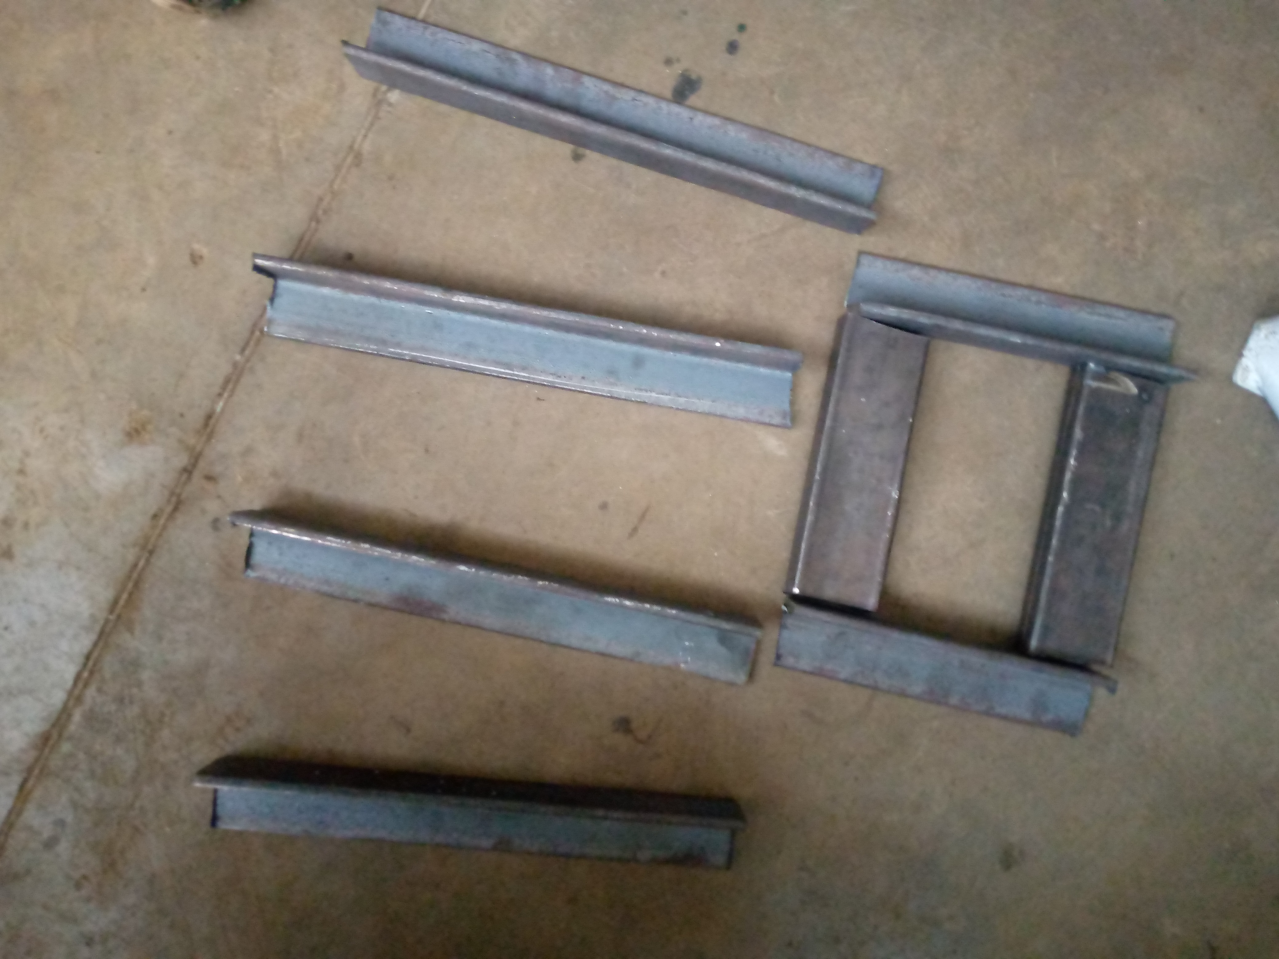
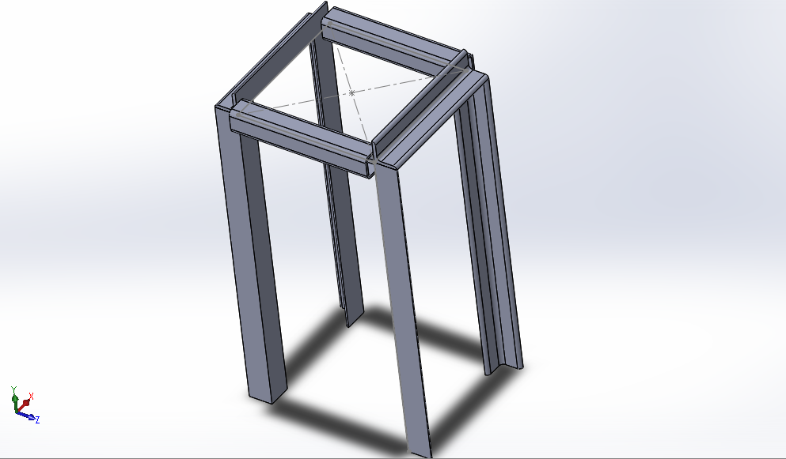
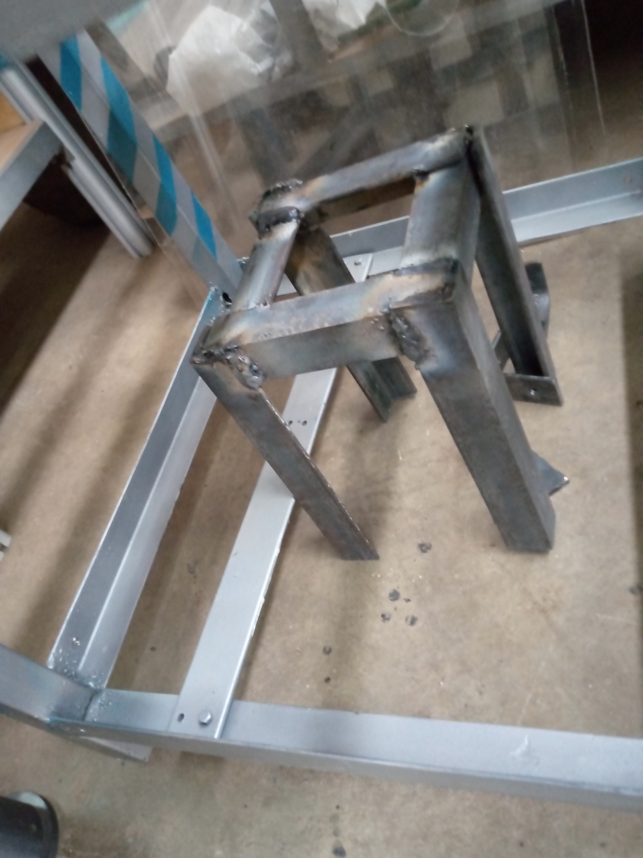
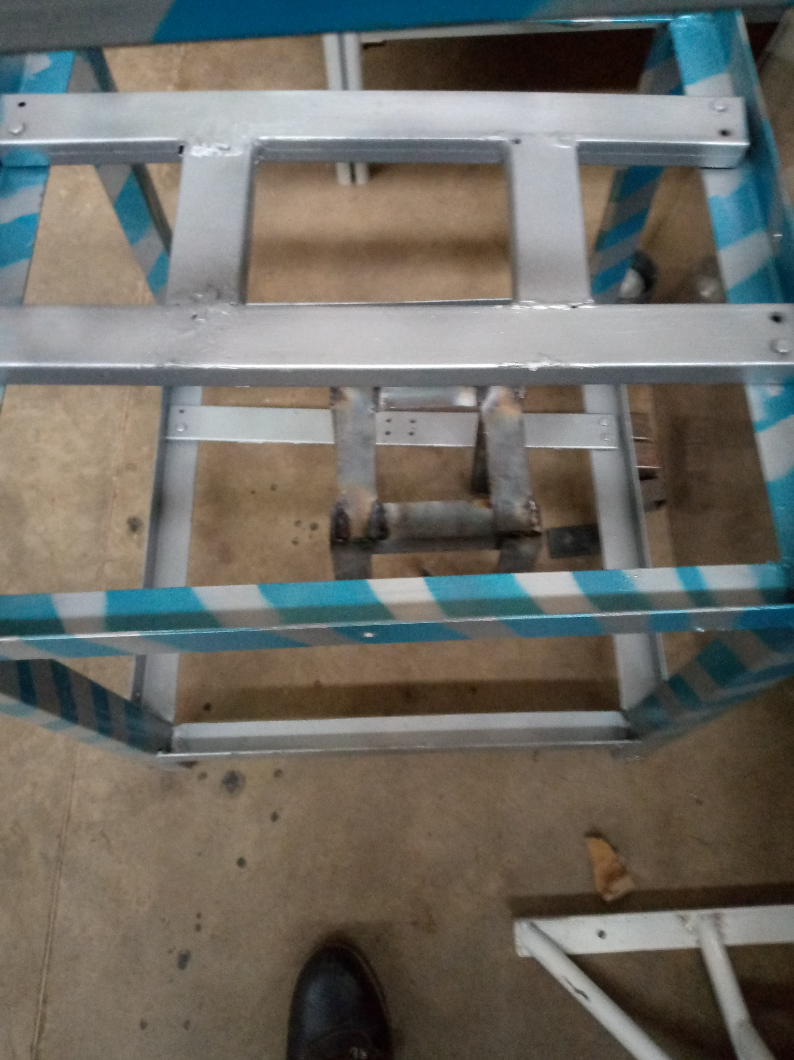
TEST STAND ATTACHMENT

Slide 5
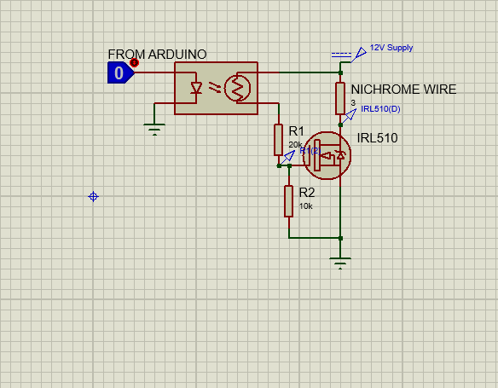
Circuits and code
LOAD CELL
IGNITION CIRCUIT
The load cell was tested and found to be faulty
The circuit and code for obtaining load cell values are all virtually finalized

Slide 6
CHALLENGES
1. GETTING THE 2 ½ INCH SCH40 PIPE FOR THE 1 GRAIN MOTOR CASING

Slide 7
NEXT WEEK’S OBJECTIVES
COOK 2 FULL GRAINS THROUGH MELTING AND RECASTING.
MAKE THE IGNITION CIRCUIT
FINALIZE ON GETTING THE 2 ½ INCH SCH40 PIPE
START AND FINISH WORKING ON THE 1 GRAIN MOTOR CASE *

